Slide 1
National CRPD Monitoring Mechanism
Monitoring CRPD
A perspective of the German NHRI

Slide 2
National Human Rights Institutions
in general:
  70 national human rights institutions worldwide
  very different sets of power and institutional set ups
  human rights-based research, policy advice and education
  common framework in terms of CRPD:
  promotion of respect of the rights of people with disabilities
  protect the rights of people with disabilities
  monitoring implementation
Notes:
There are 70 institutions worldwide

Slide 3
Monitoring Mechanisms CRPD
The German Institute for Human Rights
founded in 2001
according to Paris Principles 1993
staff of 60 members
The German National CRPD Monitoring Mechanism
mandate article 33(2) CRPD
established in 2009
own department within the German Institute for Human Rights
staff: 11 members

Slide 4
Monitoring

Slide 5
Monitoring
our working definition
  precise sector-oriented and issue-oriented observation of legal and social realities and developments
  gathering of information and its assessment in light of the human rights obligations
practical terms
  advise to federal and Länder ministries and the legislature
  review of action and policy plans, laws, etc.
Notes:
Monitoring – our working definition
Precise sector-oriented and issue-oriented observation of legal and social realities and developments
Gathering of information and its assessment in light of the human rights obligations
This process should provide constructive and critical guidance for government activities
Monitoring – in practical terms
Advise to federal and Länder ministries and the legislators
Review of action and policy plans, laws, etc.
Standard testing at the state level
Practised in a number of federal German states
Where selected areas of law are examined to ensure compliance with the CRPD

Slide 6
Promising Practices

Slide 7
Promising Practices
Civil society consultations (article 33(3) CRPD)
Parallel reporting process in Germany 2015
Focus on a selection of topics either already discussed in Germany or initiating discussion
Notes:
Special Role as an NHRI
being perceived as neutral experts
having a different mode of access to government officials and decision-makers
having the moral high ground of interpreting the contents of the CRPD in Germany
Civil Society Consultations
Two to three meetings a year
Exchange of information and experience relating to CRPD
Discussion of strategies
Parallel reporting process in Germany in 2015
Monitoring mechanism in a strong and productive role
very fruitful engagement with civil society
good results

Slide 8
Challenges

Slide 9
Challenges
Monitoring and evaluation of implementation
  keeping track of complex and fast changing realities
  data gathering
Development of human rights indicators
  the absence of indicators leads to difficulties when defining developments and progress
  very complex issue which needs sufficient resources

Slide 10








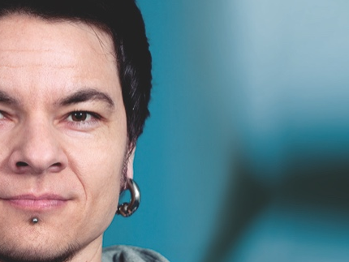
Thank you

Slide 11
National CRPD Monitoring Mechanism
Judith Striek
Researcher and Policy Adviser
Phone: ++49 30 259 359-468
striek@dimr.de
www.institut-fuer-menschenrechte.de
Twitter: @DIMR_Berlin

